Slide 1
A STOCHASTIC PROCESS FOR WORD FREQUENCY DISTRIBUTIONS
Nama Kelompok :
Hosea Yoarana (1706042913)
Leonardus Wijaya (1706042945)
Nathanael Tristan Bramantyo (1706042900)

Slide 2
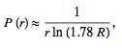
Zipf Distribution Law
given some corpus of natural language utterances, the frequency of any word is inversely proportional to its rank in the frequency table
Where r = number of different words

Slide 3
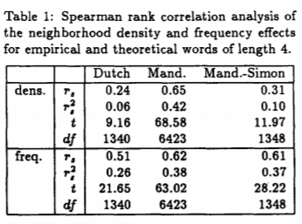
Problem
Landauer and Streeter observed that (1) highfrequency words have more neighbors than lowfrequency words (the neighborhood density effect), and that (2) high-frequency words have higher-frequency neighbors than low-frequency words (the neighborhood frequency effect).

Slide 4
Modelling
By themselves, models of the kind proposed by Zipf, Herdan and Muller or Sichel, even though they may yield reasonable fits to particular word frequency distributions, have no bearing on the similarity relations in the lexicon

Slide 5
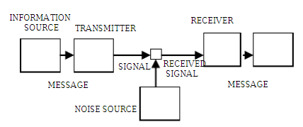
Teori Shannon and Weaver Model of communication

Slide 6
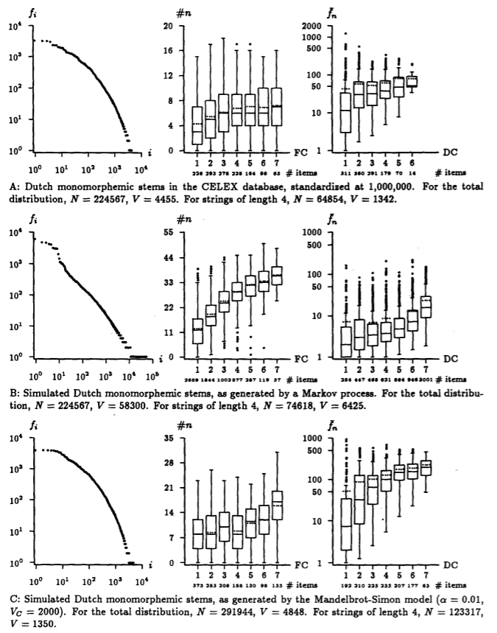
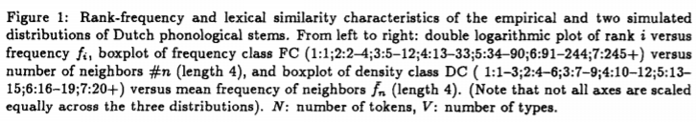

Slide 7
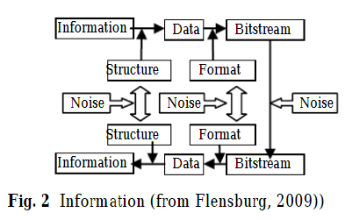

Slide 8
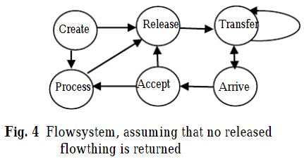
Dari fig.1 dan fig.2 dapat dibuat sebuah state diagram seperti berikut :

Slide 9
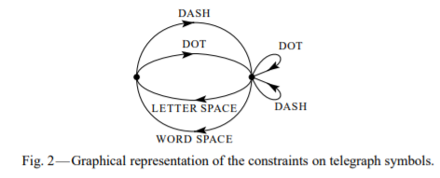
Markovian Process

Slide 10
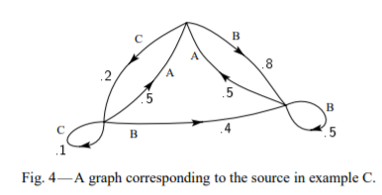
State Machine dari Markovian Process
Contoh : Diberikan suatu string A b a c a c a a b a c a b a b c a c a a

Slide 11
Simulation
Kita dapat menerapkan teori ini ke huruf, kata, dan kalimat asli dalam Bahasa inggris(alphabet). Dengan menggunakan file buku dalam bentuk .txt dapat ditunjukkan progress yang sama seperti yang dilakukan oleh Shannon mulai dari zero-order, first-order, dst.

Slide 12
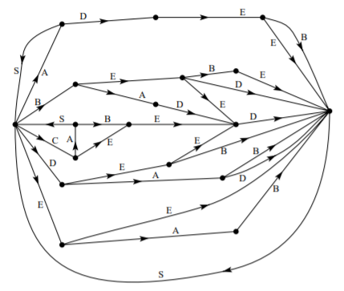
State Diagram untuk yang digunakan untuk setiap hurufnya

Slide 13
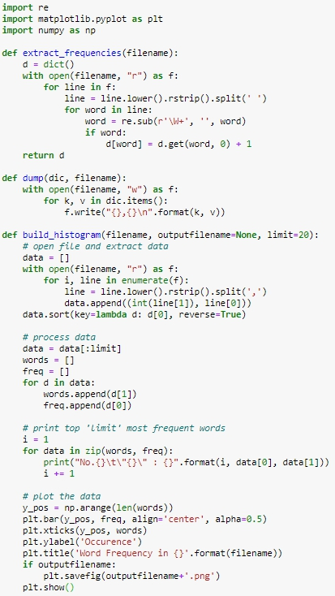

Source Code

Slide 14
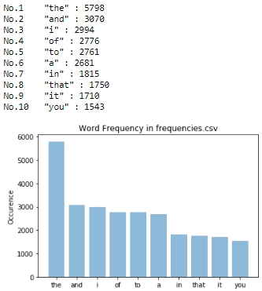
Result

Slide 15
References :
A STOCHASTIC PROCESS FOR WORD FREQUENCY DISTRIBUTIONS,1991, Harald Baayen, Maz-Planck-Institut fiir Psycholinguistik.
A Mathematical Theory of Communication, 1948, C. E. SHANNON, Reprinted with corrections from The Bell System Technical Journal.
https://www.wordfrequency.info/free.asp?s=y
http://www.wordcount.org/main.php

